Slide 1
Multipexer dan DeMultiplexer
Prof. Hsien-Hsin Sean Lee
School of Electrical and Computer Engineering
Georgia Tech

Slide 2
Combinational Logic
N
inputs
Combinational
circuits
M
outputs
Outputs, “at any time”, are determined by the input combination
We will discuss
  Multiplexers / De-Multiplexers
  Decoders / Encoders

Slide 3
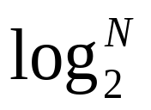
Multiplexers (Mux)
Fungsi: Menyeleksi banyak input
Mengirimkan 1 dari N input (A) ke output F
Membutuhkan bit seleksi (S)
Bit Enable: dapat menahan input dan men-set F = 0
En
A₀
A₁
F
4-to-1
Mux
A₂
A₃
S₁
S₀

Slide 4
Multiplexers (Mux) w/out Enable
S1 | S0 | A3 | A2 | A1 | A0 | F
0 | 0 | X | X | X | 0 | 0
0 | 1 | X | X | 0 | X | 0
1 | 0 | X | 0 | X | X | 0
1 | 1 | 0 | X | X | X | 0
0 | 0 | X | X | X | 1 | 1
0 | 1 | X | X | 1 | X | 1
1 | 0 | X | 1 | X | X | 1
1 | 1 | 1 | X | X | X | 1
A₀
A₁
F
4-to-1
Mux
A₂
A₃
S₁
S₀

Slide 5
Multiplexers (Mux) w/out Enable
A₀
S1 | S0 | F
0 | 0 | A0
0 | 1 | A1
1 | 0 | A2
1 | 1 | A3
A₁
F
4-to-1
Mux
A₂
A₃
S₁
S₀

Slide 6
Logic Diagram of a 4-to-1 Mux
S1
S0
F
A0
A1
S1 | S0 | F
0 | 0 | A0
0 | 1 | A1
1 | 0 | A2
1 | 1 | A3
A2
A3

Slide 7
Logic Diagram of a 4-to-1 Mux
S1=0
1
S0=0
1
F
A0
A0
A1
S1 | S0 | F
0 | 0 | A0
0 | 1 | A1
1 | 0 | A2
1 | 1 | A3
A2
A3

Slide 8
Logic Diagram of a 4-to-1 Mux
S1=0
1
A0
S0=0
1
F
A0
A1
S1 | S0 | F
0 | 0 | A0
0 | 1 | A1
1 | 0 | A2
1 | 1 | A3
A2
A3

Slide 9
Logic Diagram of a 4-to-1 Mux
S1=0
1
S0=1
F
A0
1
A1
A1
S1 | S0 | F
0 | 0 | A0
0 | 1 | A1
1 | 0 | A2
1 | 1 | A3
A2
A3

Slide 10
Logic Diagram of a 4-to-1 Mux
S1=0
1
S0=1
F
A0
A1
1
A1
S1 | S0 | F
0 | 0 | A0
0 | 1 | A1
1 | 0 | A2
1 | 1 | A3
A2
A3

Slide 11
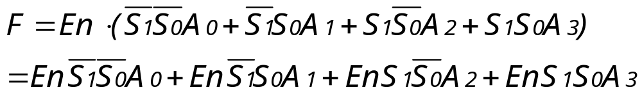
Multiplexers (Mux) w/ Enable
En
En | S1 | S0 | F
0 | X | X | 0
1 | 0 | 0 | A0
1 | 0 | 1 | A1
1 | 1 | 0 | A2
1 | 1 | 1 | A3
A₀
A₁
F
4-to-1
Mux
A₂
A₃
S₁
S₀

Slide 12
4-to-1 Mux w/ Enable Logic
S1
S0
F
A0
A1
A2
A3
En

Slide 13
4-to-1 Mux w/ Enable Logic
S1
S0
F
A0
A1
Reduce one Gate Delay
by using 4-input
AND gate for the 2nd
level
A2
A3
En
En

Slide 14
Quadruple 2-to-1 Line Mux
En
A[3:0]
A_{3..0}
2-to-1
Mux
(4-bit bus)
F[3:0]
En | SEL | F[3:0]
0 | X | 0000
1 | 0 | A[3:0]
1 | 1 | B[3:0]
B_{3..0}
B[3:0]
SEL

Slide 15
Quadruple 2-to-1 Line Mux
A₀
F₀
A₁
F₁
F_{x}=A_{x}·En·SEL+B_{x}·En·SEL
A₂
F₂
A₃
F₃
En | SEL | F[3:0]
0 | X | 0000
1 | 0 | A[3:0]
1 | 1 | B[3:0]
SEL
B₀
B₁
B₂
B₃
En

Slide 16
8-to-1 MUX
0
A₀
1
A₁
1
A₂
8-to-1
Mux
0
F= ?
A₃
0
A₄
Each input in a MUX is a minterm
0
A₅
1
A₆
1
A₇
S₂
S₁
S₀
A
B
C

Slide 17
Demultiplexers (DeMux)
A₀
D₀
A₁
F
D₁
4-to-1
Mux
A
1-to-4
DeMux
A₂
D₂
A₃
D₃
S₁
S₀
S₁
S₀

Slide 18
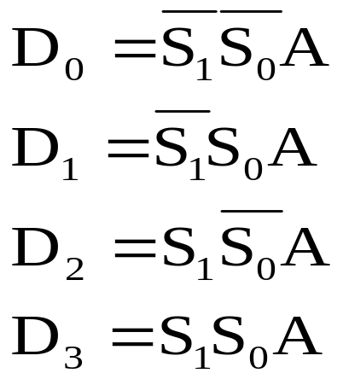
DeMux Operations
S1 | S0 | D3 | D2 | D1 | D0
0 | 0 | 0 | 0 | 0 | A
0 | 1 | 0 | 0 | A | 0
1 | 0 | 0 | A | 0 | 0
1 | 1 | A | 0 | 0 | 0
D₀
D₁
A
1-to-4
DeMux
D₂
D₃
S₁
S₀

Slide 19
DeMux Operations
S1 | S0 | D3 | D2 | D1 | D0
0 | 0 | 0 | 0 | 0 | A
0 | 1 | 0 | 0 | A | 0
1 | 0 | 0 | A | 0 | 0
1 | 1 | A | 0 | 0 | 0
S1
D0
S0
D1
D2
D3
A

Slide 20
DeMux Operations
S1 | S0 | D3 | D2 | D1 | D0
0 | 0 | 0 | 0 | 0 | A
0 | 1 | 0 | 0 | A | 0
1 | 0 | 0 | A | 0 | 0
1 | 1 | A | 0 | 0 | 0
S1=0
1
1
D0
S0=0
D1
D2
D3
A
A

Slide 21
DeMux Operations
S1 | S0 | D3 | D2 | D1 | D0
0 | 0 | 0 | 0 | 0 | A
0 | 1 | 0 | 0 | A | 0
1 | 0 | 0 | A | 0 | 0
1 | 1 | A | 0 | 0 | 0
S1=1
D0
S0=1
1
D1
1
D2
D3
A
A

Slide 22
DeMux Operations w/ Enable
S1
D0
En | S1 | S0 | D3 | D2 | D1 | D0
0 | X | X | 0 | 0 | 0 | 0
1 | 0 | 0 | 0 | 0 | 0 | A
1 | 0 | 1 | 0 | 0 | A | 0
1 | 1 | 0 | 0 | A | 0 | 0
1 | 1 | 1 | A | 0 | 0 | 0
S0
D1
D2
D3
En
A

